Slide 1
Send SMS through Excel

Slide 2
Open Below Link
http://www.smsidea.biz/

Slide 3

Click on free Signup

Slide 4
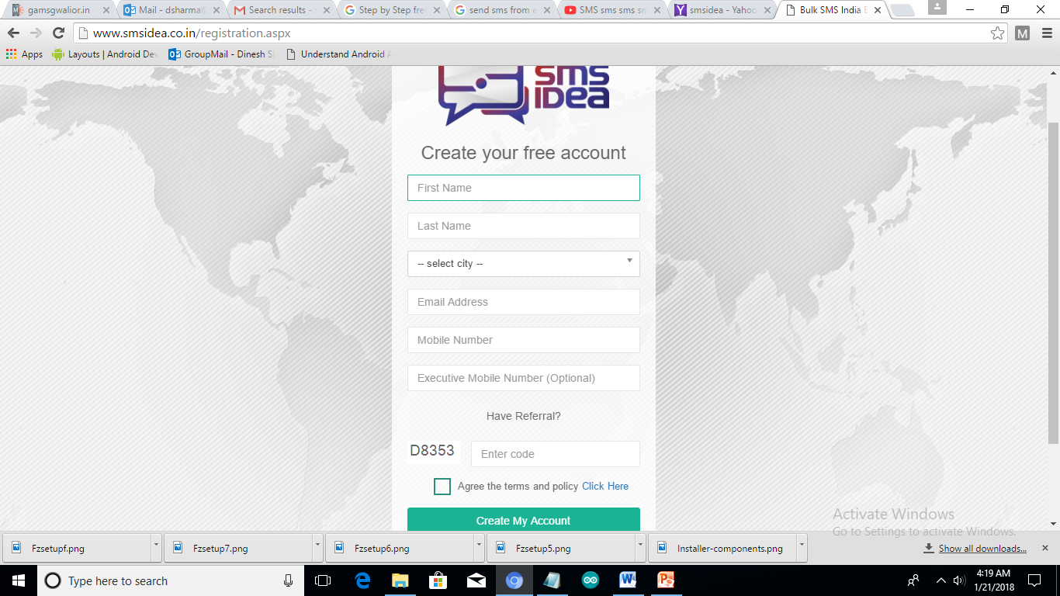
Fill the form and click on create my account

Slide 5
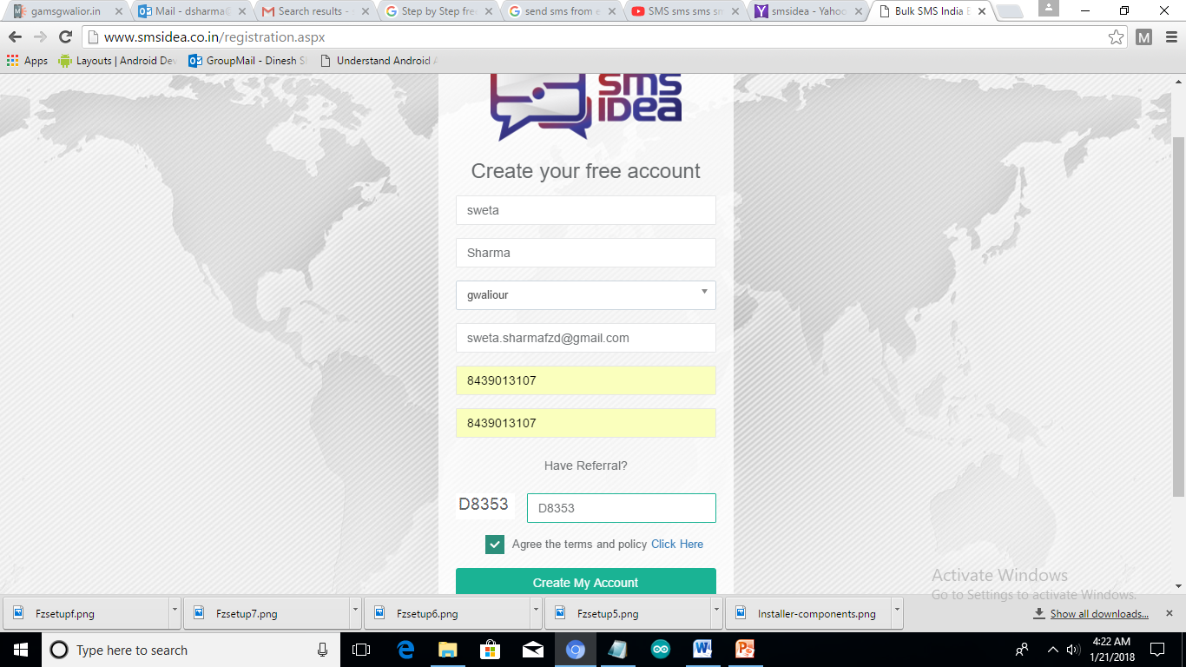

Slide 6
Check your Mobile Message for Username and Password
Click on Login

Slide 7
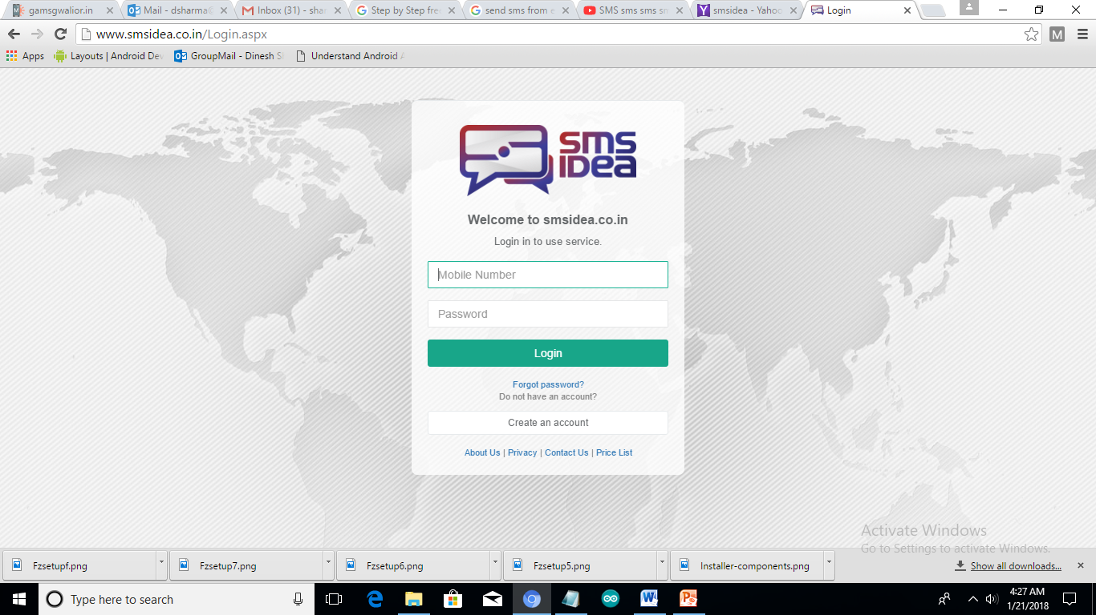
Enter your Mobile Number and Password

Slide 8
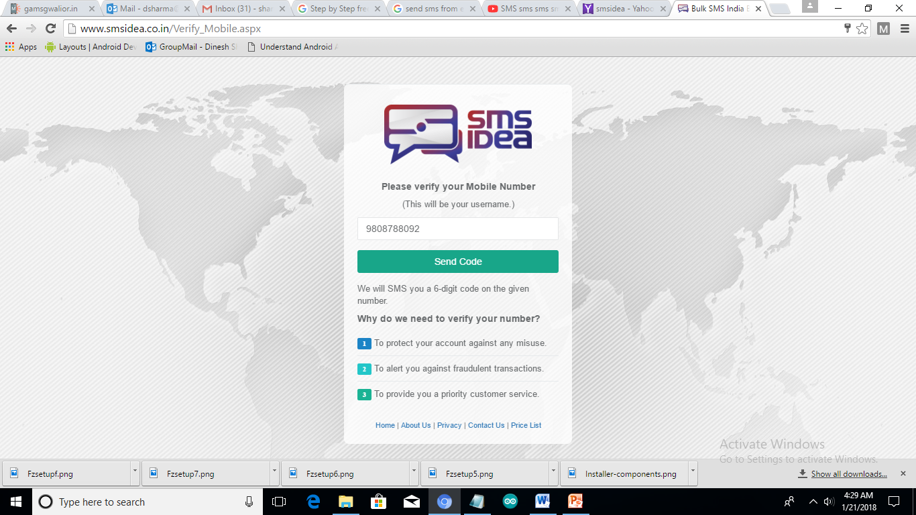
Send Code for Mobile Number Verification

Slide 9
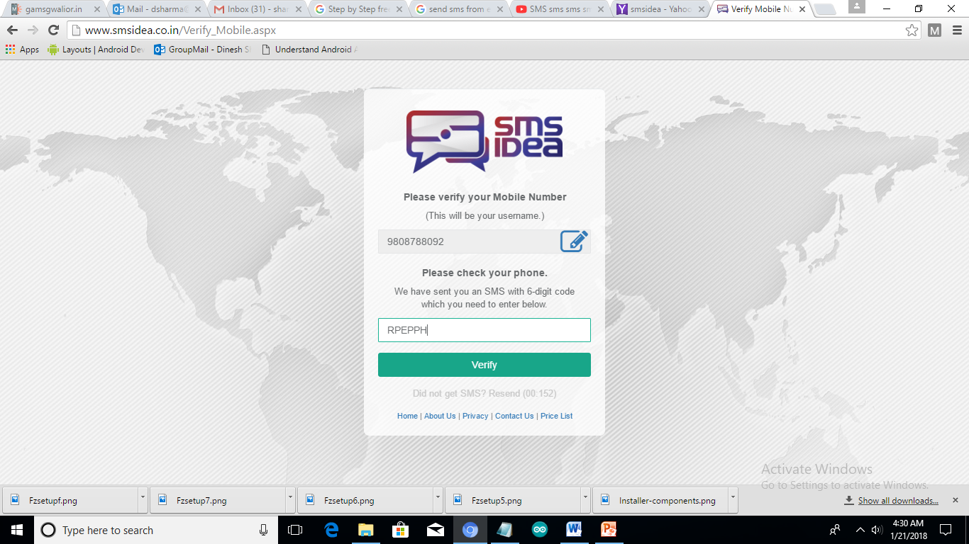
Enter Verification Code and Click on Verify

Slide 10
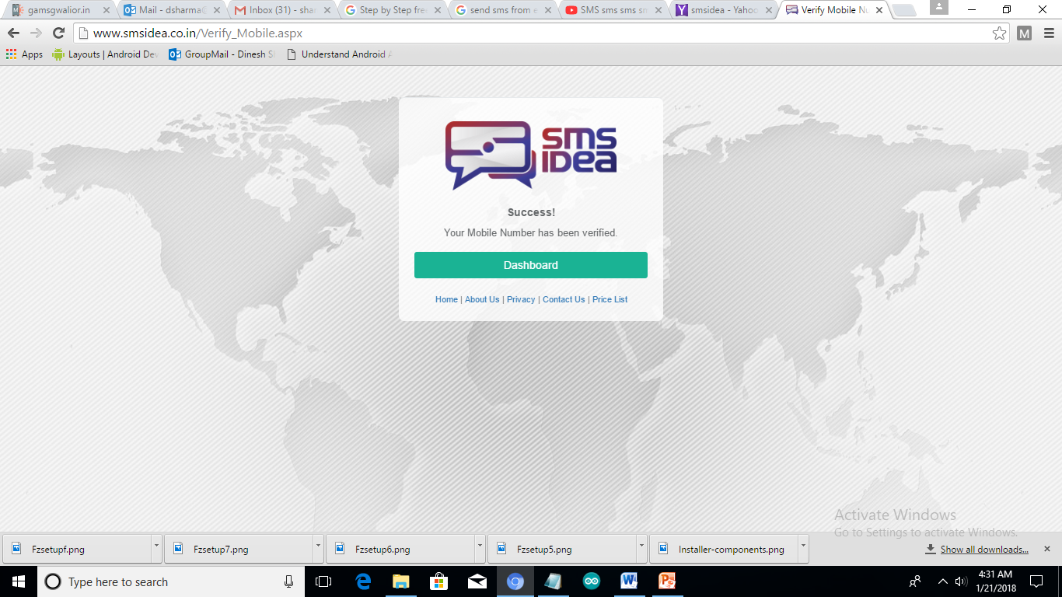
Click on Dashboard

Slide 11
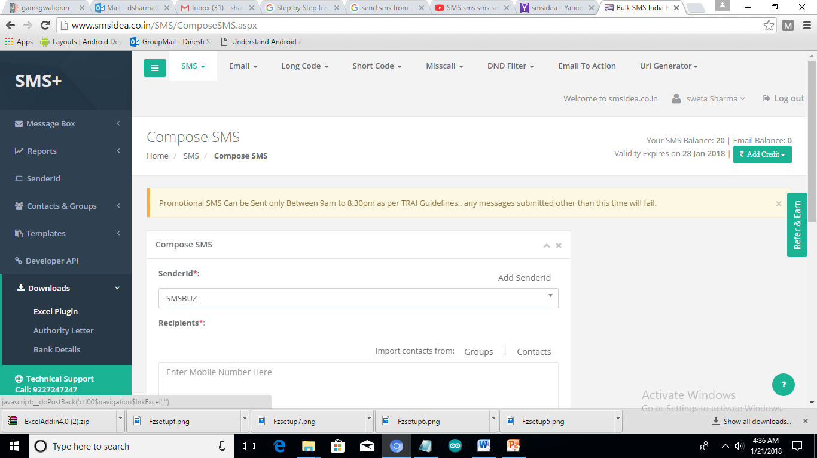
Expand Download and Click on Excel Plugin

Slide 12
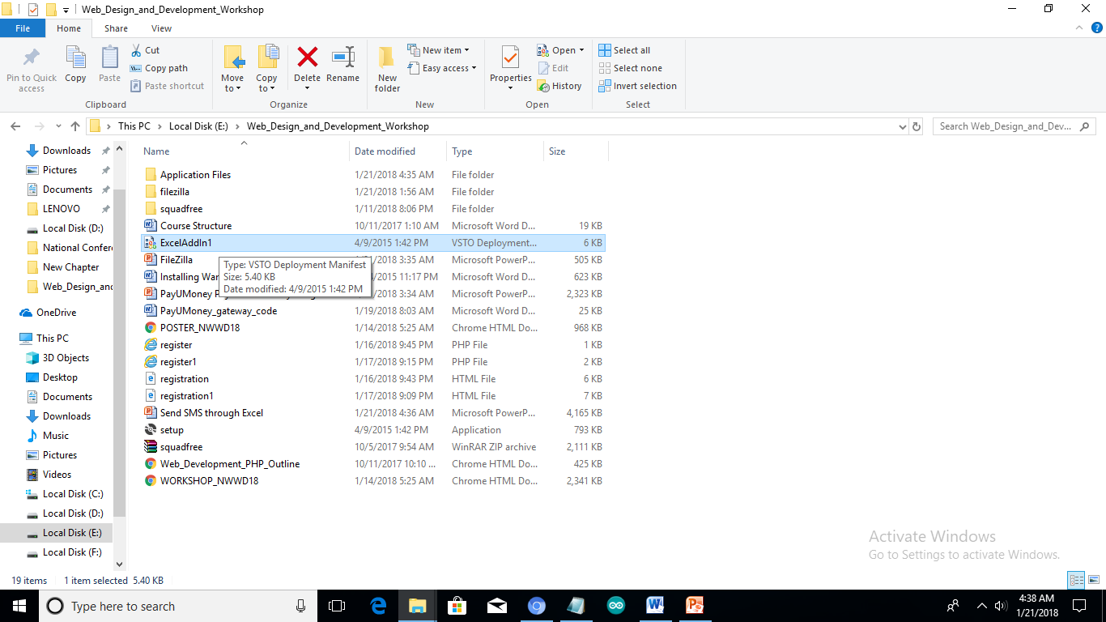
Extract Download File and Click on ExcelAddin File

Slide 13
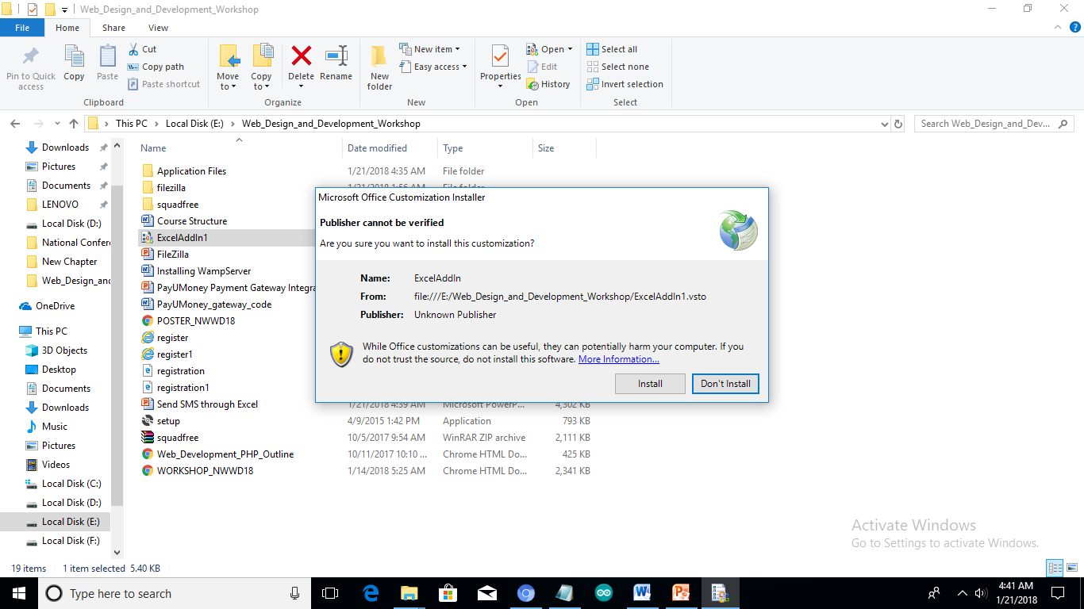
Install ExcelAddin

Slide 14
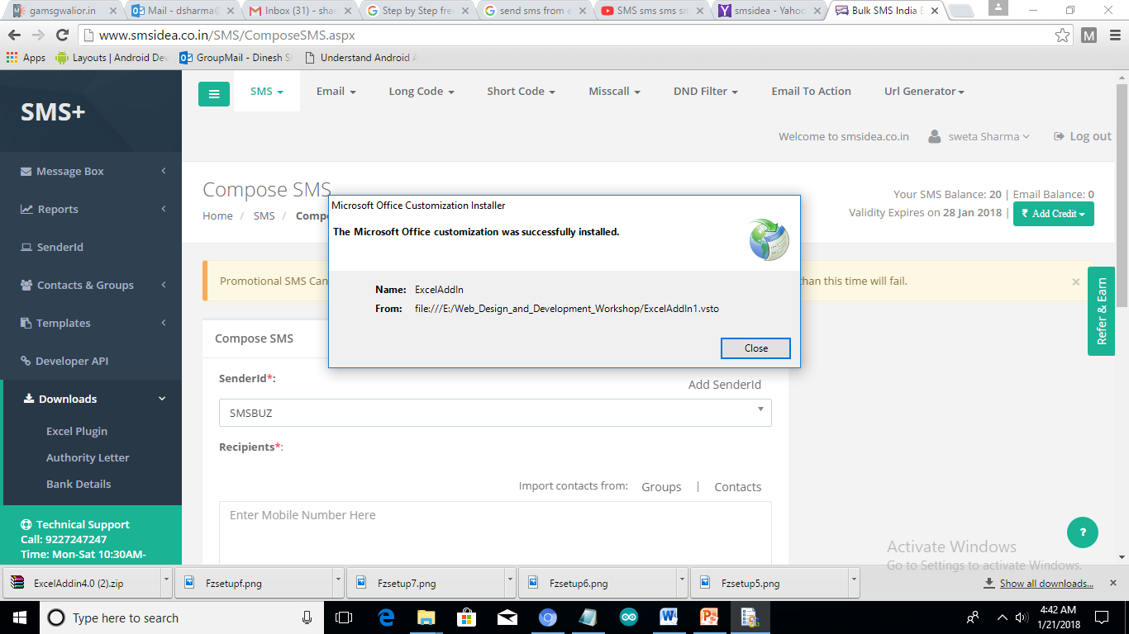
Click on Close button

Slide 15
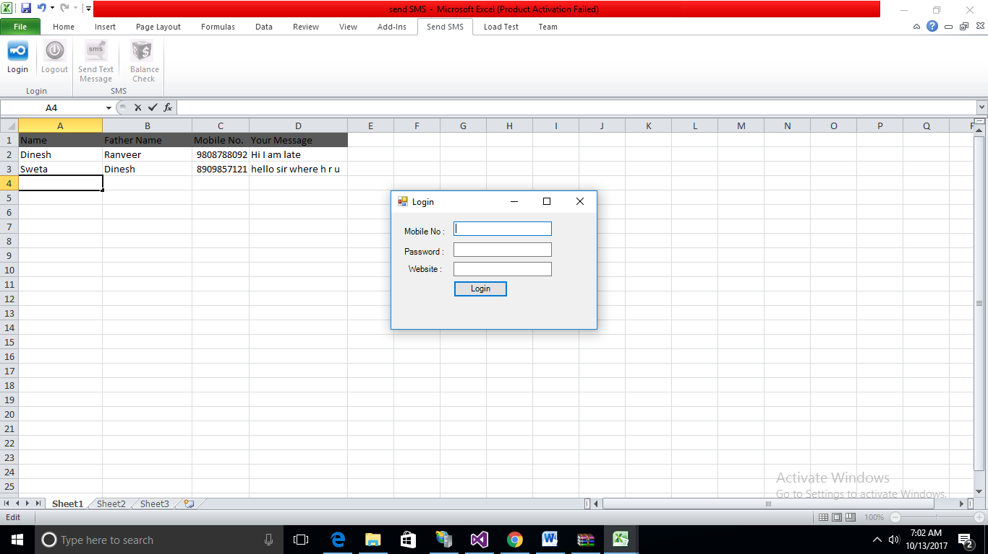
Now Open Excel and Fill Your Data

Slide 16
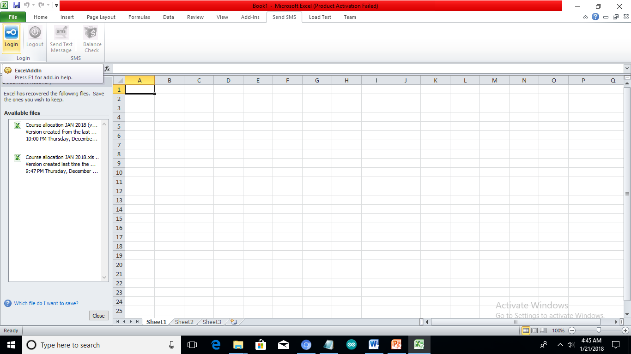
Now Click on Send SMS Tab and Click on Login Button for Login

Slide 17
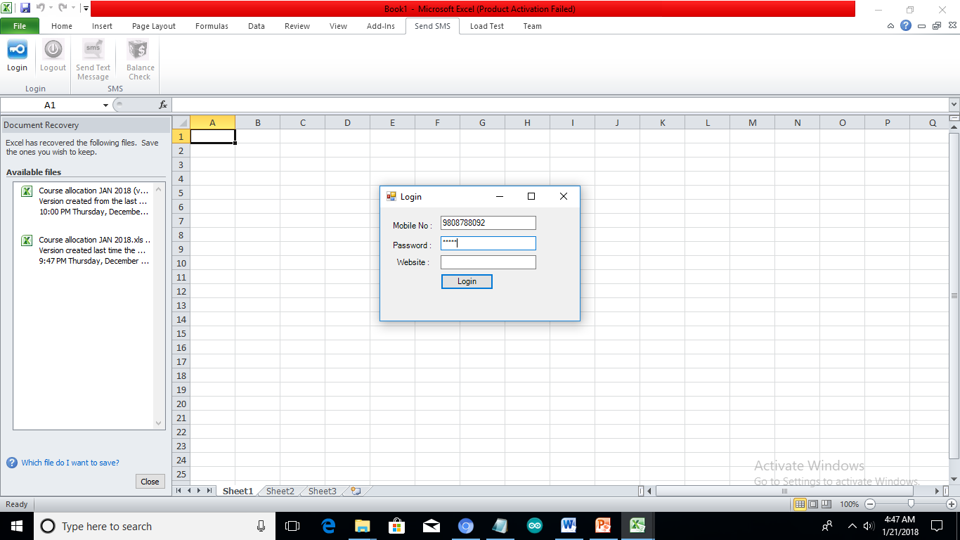
Enter Mobile Number and Password and website name-smsidea.co.in

Slide 18
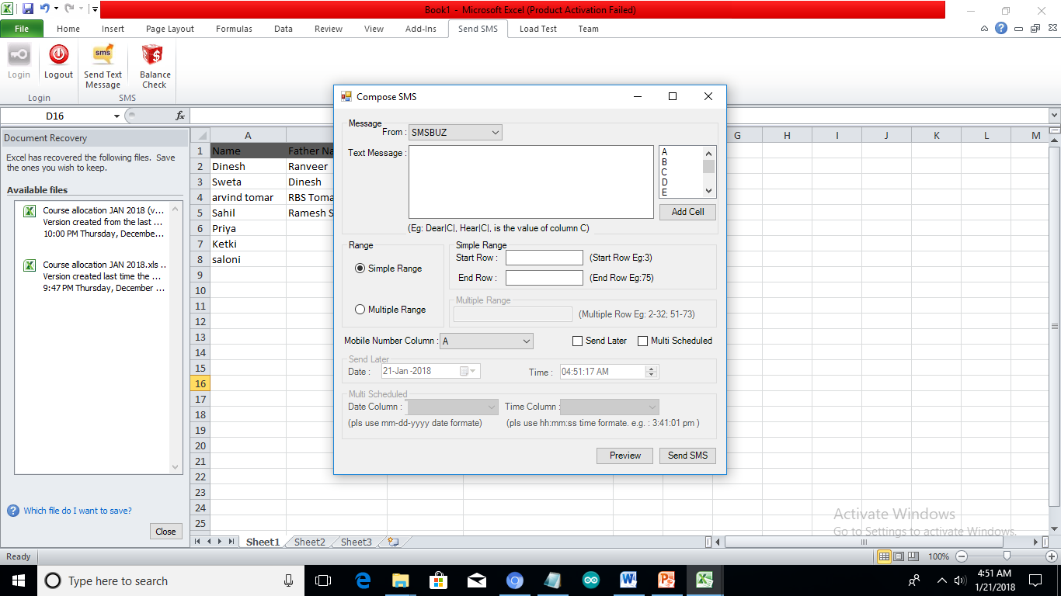
Click on Send Text Message Button

Slide 19
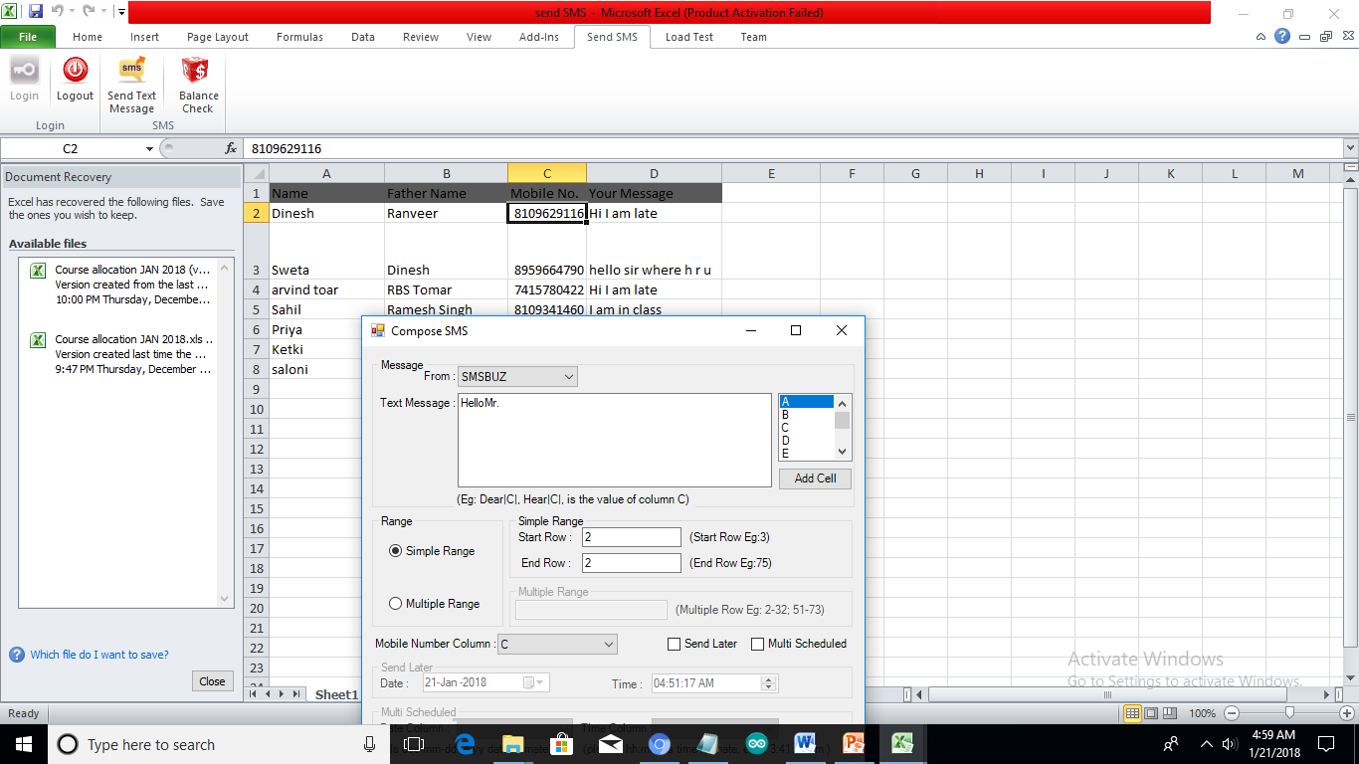
Now Type Hello Mr. then Select Column Which contain Name

Slide 20
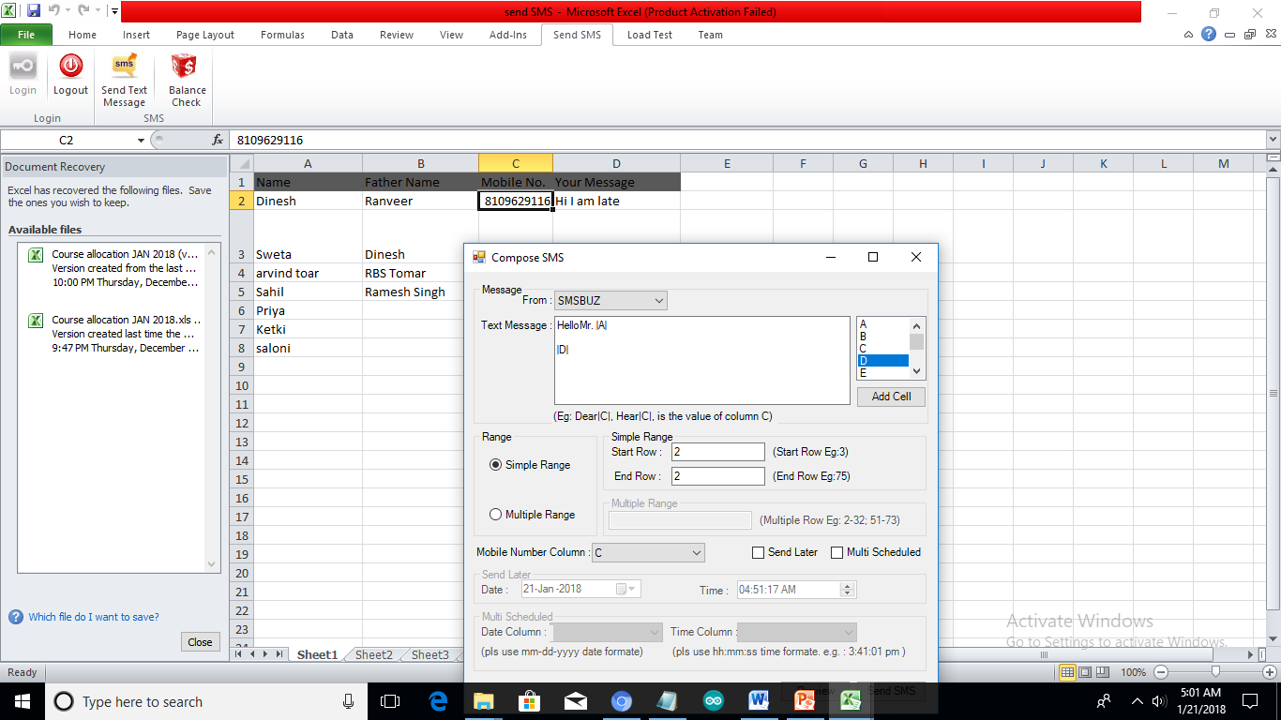
Press Enter And Select Column Which Contain Message

Slide 21
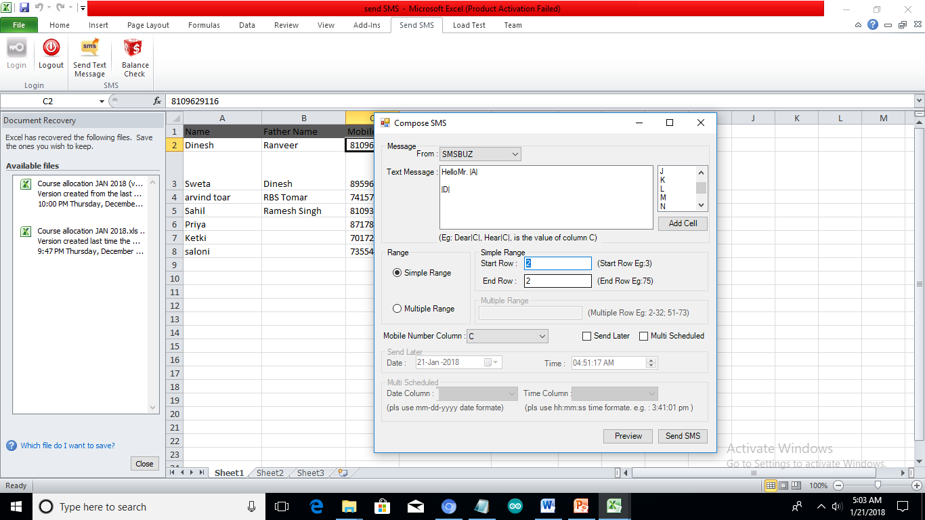
Then Select Start and End Row for selecting number of persons for sending Message

Slide 22
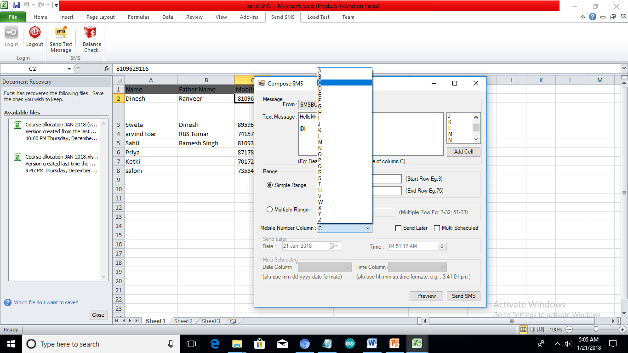
Select Mobile Number Column

Slide 23
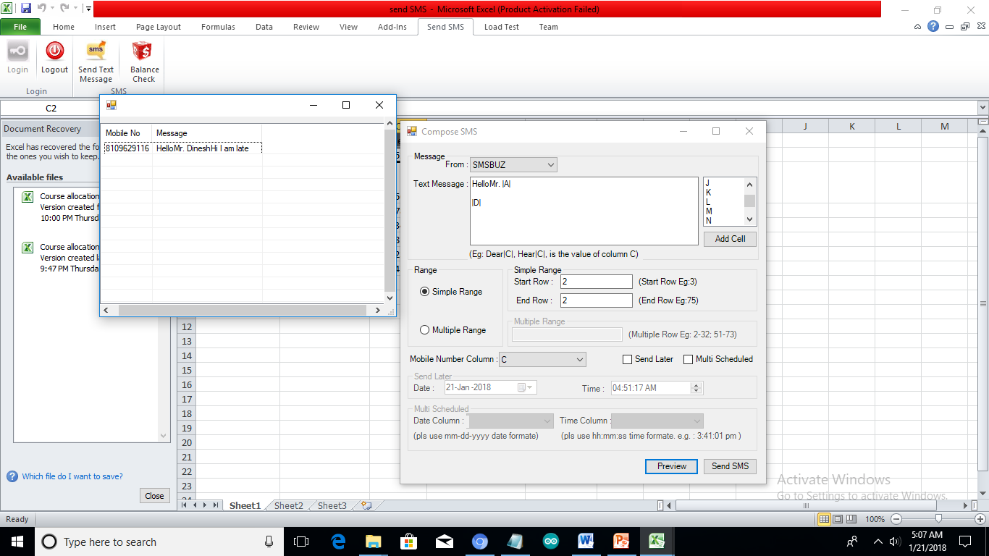
Click on Preview Button

Slide 24
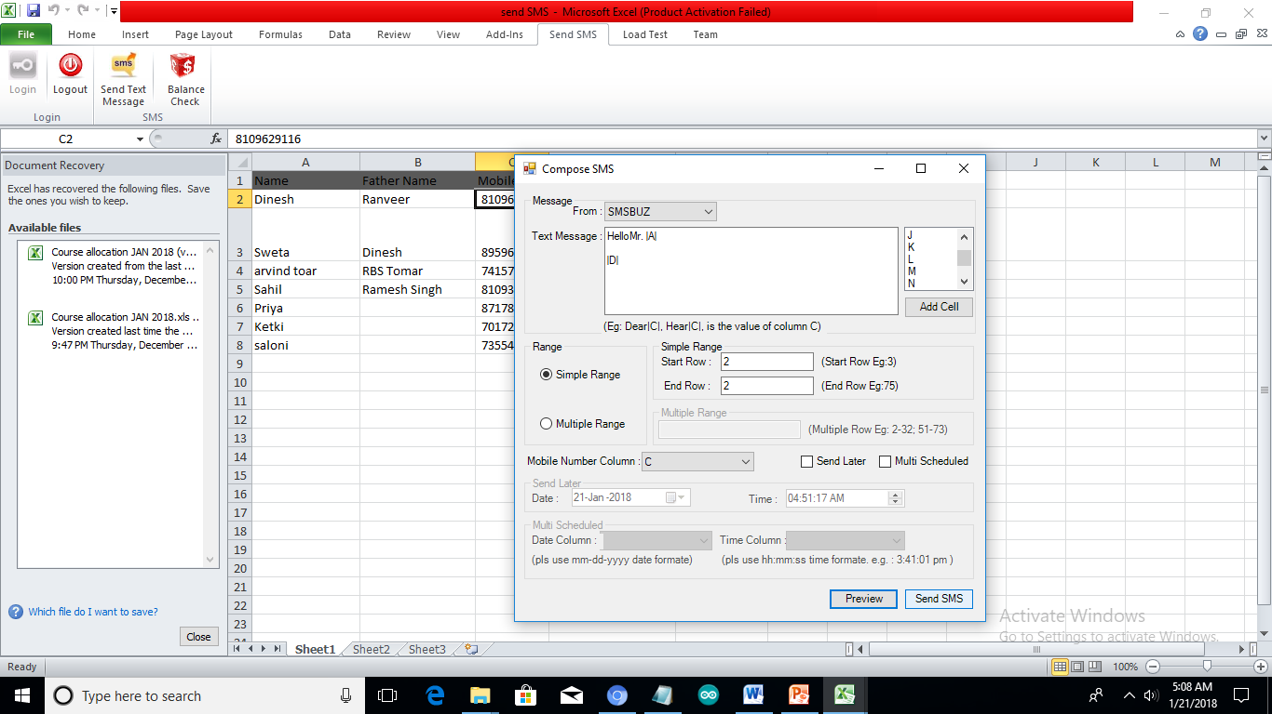
Finally Click on Send SMS Button and Message sent or not

